Slide 1

DMDW Lab using PYTHON
5th Semester
Department of Computer Science and Engineering
GIET University, Gunupur

Slide 2
Assignment 1

Slide 3
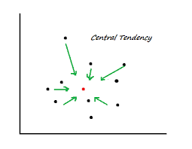
Measures of Central Tendency
It describes distribution of data focusing on central location around which all other data
are clustered.

Slide 4
Measures of Central Tendency
It attempts to describe set of data by identifying the central position within which data is set.
Measure of central tendency:
1. Mean
2. Median
3. Mode

Slide 5
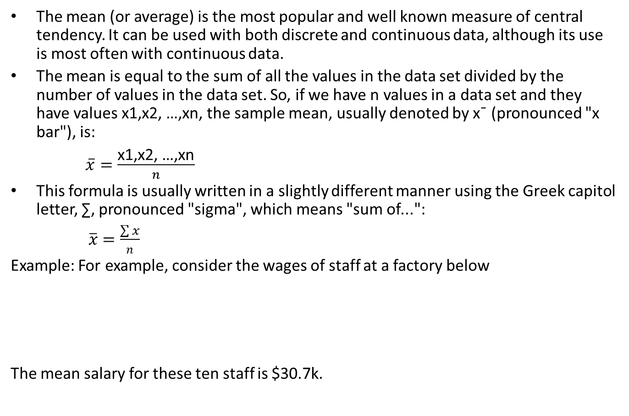
Mean
The mean (or average) is the most popular and well known measure of central tendency. It can be used with both discrete and continuous data, although its use is most often with continuous data.
The mean is equal to the sum of all the values in the data set divided by the number of values in the data set. So, if we have n values in a data set and they have values x1,x2, …,xn, the sample mean, usually denoted by x¯ (pronounced "x bar"), is:
$$\overline{x}=\frac{\text{x}\text{1,}\text{x}\text{2, …,}\text{xn}}{n}$$
This formula is usually written in a slightly different manner using the Greek capitol letter, ∑, pronounced "sigma", which means "sum of...":
$$\overline{x}=\frac{\sum{x}}{n}$$
Example: For example, consider the wages of staff at a factory below
The mean salary for these ten staff is $30.7k.
Staff | 1 | 2 | 3 | 4 | 5 | 6 | 7 | 8 | 9 | 10
Salary | 15k | 18k | 16k | 14k | 15k | 15k | 12k | 17k | 90k | 95k

Slide 6
Median
The median is the middle score for a set of data that has been arranged in order of magnitude.
The median is less affected by outliers and skewed data. In order to calculate the median, suppose we have the data below
Ex-1) 65 55 89 56 35 14 56 55 87 45 92
Our median mark is the middle mark - in this case is 56
Ex-2)
We first need to rearrange that data into order of magnitude
14 | 35 | 45 | 55 | 55 | 56 | 56 | 65 | 87 | 89 | 92
65 | 55 | 89 | 56 | 35 | 14 | 56 | 55 | 87 | 45
We again rearrange that data into order of magnitude (smallest first):
Only now we have to take the 5th and 6th score in our data set and
average them to get a median of 55.5.
14 | 35 | 45 | 55 | 55 | 56 | 56 | 65 | 87 | 89

Slide 7
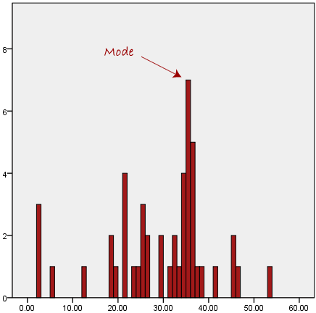
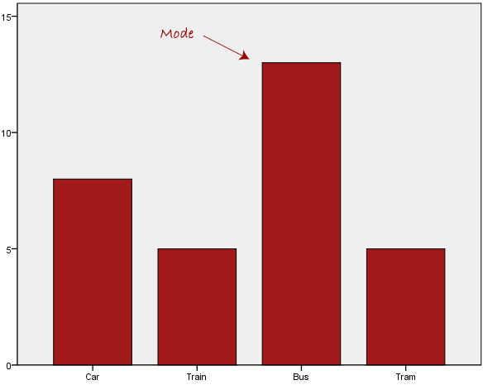
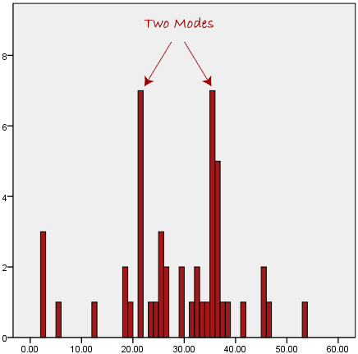
Mode
The mode is the most frequent score in our data set. On a histogram it represents the highest bar in a bar chart or histogram in fig-1.
Fig-1
Fig-2
Fig-3
Normally, the mode is used for categorical data where we wish to know which is the most common category, as illustrated in fig-2.
However, one of the problems with the mode is that it is not unique, so it leaves us with problems when we have two or more values that share the highest frequency, such as fig-3.

Slide 8
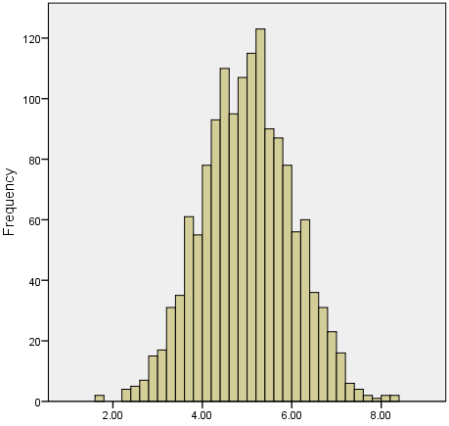
Skewed Distributions
An example of a normally distributed set of data is presented below.
In any symmetrical distribution the mean, median and mode are equal.
Mean is widely preferred as the best measure of central tendency because it is the measure that includes all the values in the data set for its calculation.

Slide 9
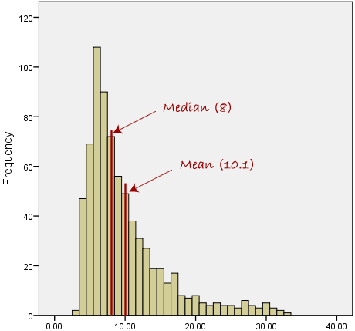
Contd.
However, when our data is skewed, for example, as with the right-skewed data set below:
Median is generally considered to be the best representative of the central location of the data.
The more skewed the distribution, the greater the difference between the median and mean .
The greater emphasis should be placed on using the median as opposed to the mean.

Slide 10
Summary of when to use the mean, median and mode
Please use the following summary table to know what the best measure of central tendency is with respect to the different types of variable.
Type of Variable | Best measure of central tendency
Nominal | Mode
Ordinal | Median
Interval/Ratio (not skewed) | Mean
Interval/Ratio (skewed) | Median

Slide 11
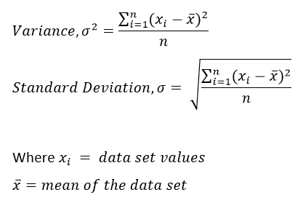
Variance and Standard Deviation

Slide 12
Example
The ages of you and your friends are 25, 26, 27, 30, and 32.
First, we must find the mean age: (25 + 26 + 27 + 30 + 32) / 5 = 28.
Then, we need to calculate the differences from the mean for each of the 5 friends.
25 – 28 = -3 26 – 28 = -2 27 – 28 = -1 30 – 28 = 2 32 – 28 = 4
Next, to calculate the variance, we take each difference from the mean, square it, then average the result.
Variance = ( (-3)² + (-2)² + (-1)² + 2² + 4²)/ 5
= (9 + 4 + 1 + 4 + 16 ) / 5 = 6.8
Variance is 6.8. Standard deviation is the square root of the variance, which is 2.61.

Slide 13
PRACTICE-1
Write the python code for following statistical operations with and without library function:
Mean
Median
Mode
Standard Deviation and
Variance

Slide 14
Mean Without Library Function
# Mean without using library
n_num = [1, 2, 3, 4, 5]
n = len(n_num)
get_sum = sum(n_num)
mean = get_sum / n
print("Mean / Average is: " + str(mean))

Slide 15
Median without library function
# Median without using library
n_num = [1, 2, 3, 4, 5]
n = len(n_num)
n_num.sort()
if n % 2 == 0:
median1 = n_num[n//2]
median2 = n_num[n//2 - 1]
median = (median1 + median2)/2
else:
median = n_num[n//2]
print("Median is: " + str(median))

Slide 16
Mode without library function
# Python program to print mode of elements
from collections import Counter
n_num = [1, 2, 3, 4, 5, 5]
n = len(n_num)
data = Counter(n_num)
get_mode = dict(data)
mode = [k for k, v in get_mode.items() if v== max(list(data.values()))]
if len(mode) == n:
get_mode = "No mode found"
else:
get_mode = "Mode is / are: " + ', '.join(map(str, mode))
print(get_mode)

Slide 17
Mode with library function
import numpy
speed = [99,86,87,88,111,86,103,87,94,78,77,85,86]
x = numpy.mean(speed)
y = numpy.median(speed)
s = numpy.std(speed)
v = numpy.var(speed)
print(x)
print(y)
print(s)
print(v)

Slide 18
Mode with library function
from scipy import stats
speed = [99,86,87,88,111,86,103,87,94,78,77,85,86]
x = stats.mode(speed)
print(x)

Slide 19
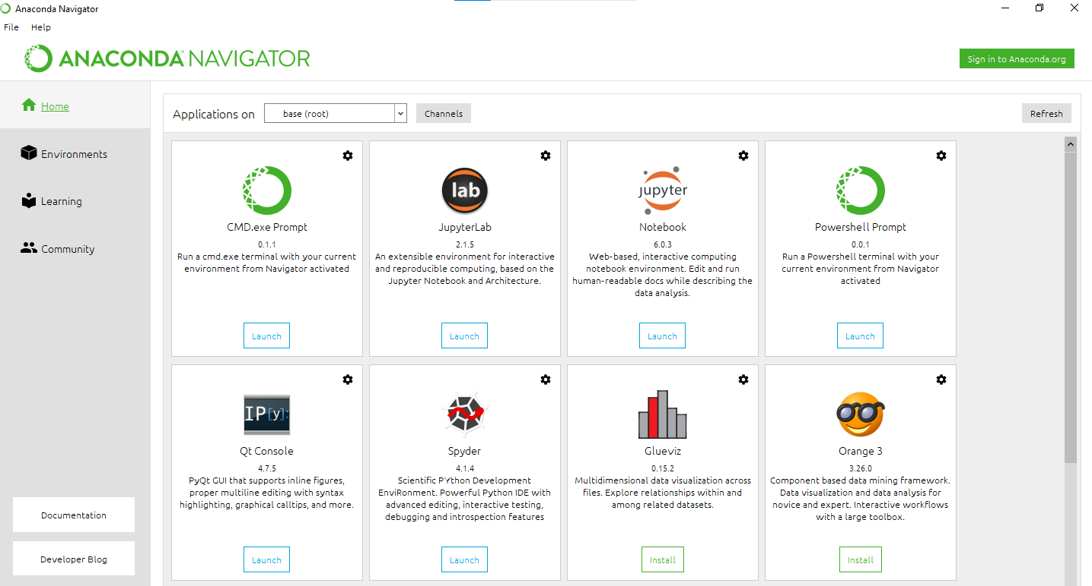
Anaconda Platform
Anaconda Individual Edition is the world's most popular Python distribution platform with over 20 million users worldwide.
Anaconda Navigator is a desktop graphical user interface (GUI) included in Anaconda distribution that allows users to launch applications and manage conda packages, environments and channels without using command-line commands.

Slide 20
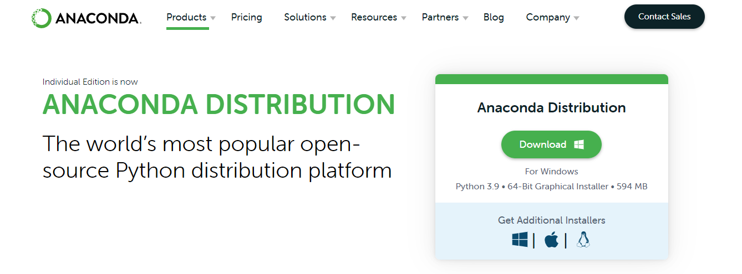
Anaconda Installation Steps
https://www.anaconda.com/products/distribution#windows

Slide 21
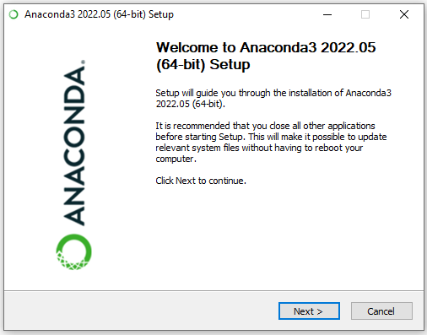

Slide 22
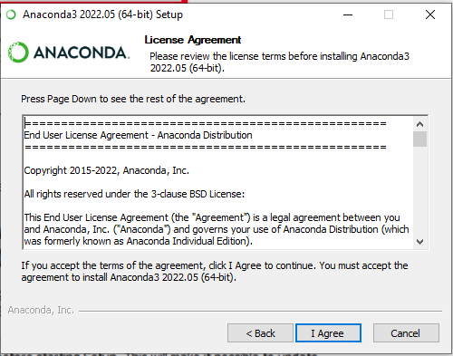
3. Now, you’ll see the license agreement. Click on ‘I Agree’

Slide 23
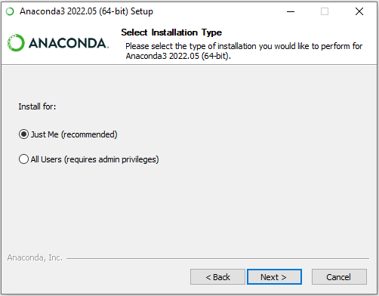
4. You can install it for all users or just for yourself. If you want to install it for all users, you need administrator priveleges.

Slide 24
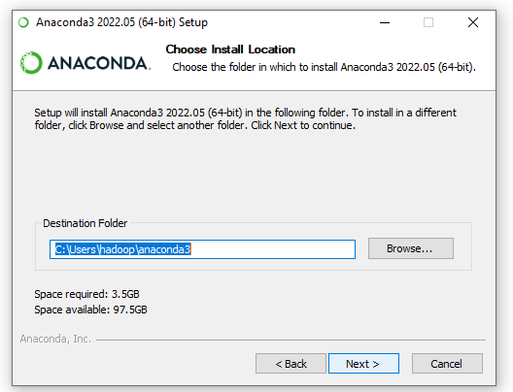
5. Choose where you want to install it. Here, you can see the available space and how much you need.

Slide 25
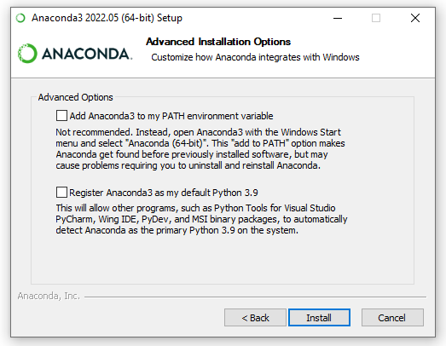
6. Now, you’ll get some advanced options. You can add Anaconda
to your system’s PATH environment vairable, and register it as
the primary system Python 3.7. If you add it to PATH, it will
found before any other installation. Click on ‘Install’.

Slide 26
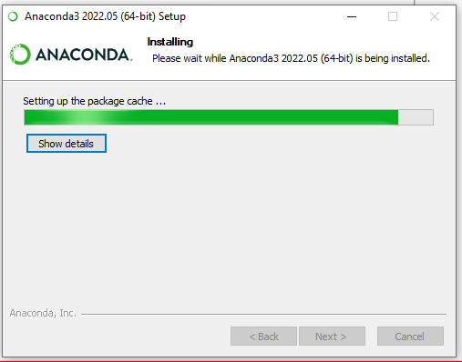
7. It will unpack some packages and extract some files on your
Machine. This will take a few minutes.

Slide 27
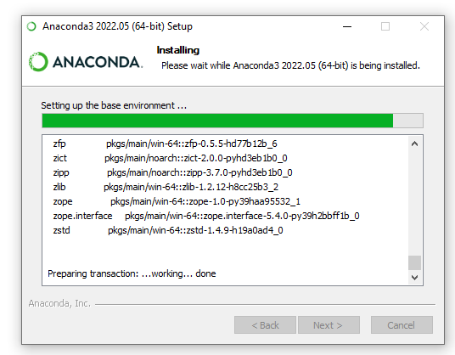

Slide 28
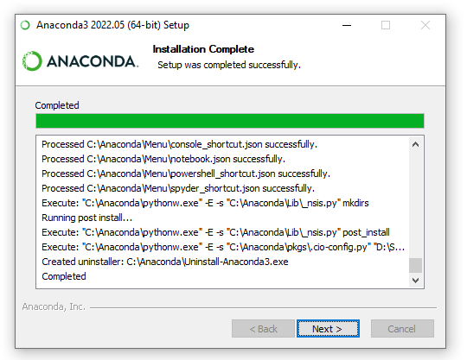

Slide 29
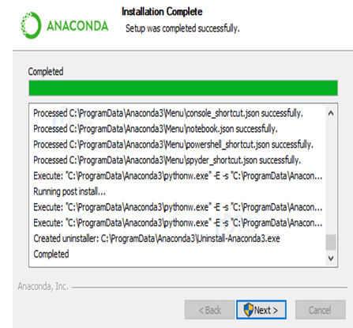
8. The installation is complete. Click Next.

Slide 30
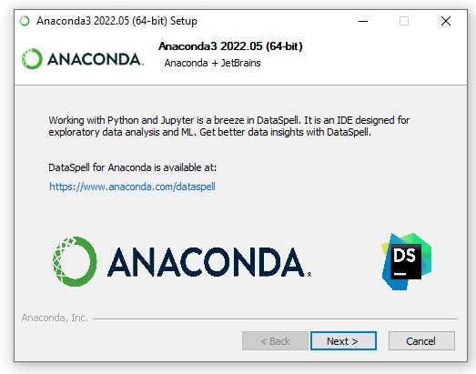
9. This screen will inform you about JetBrains.

Slide 31
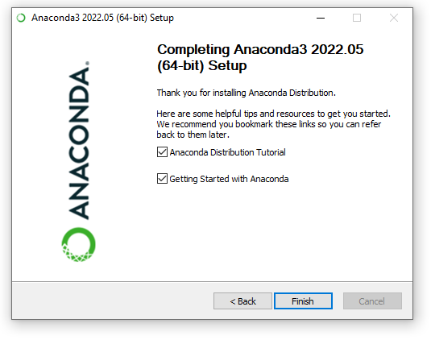
The installation is complete. You can choose to get more
Information Anaconda cloud and how to get started with Anaconda. Click Finish.

Slide 32
Benefits of Using Python Anaconda
It is free and open-source
It has more than 1500 Python/R data science packages
It creates an environment that is easily manageable for deploying any project
Download more than 1500 Python/R data science packages
Manage libraries, dependencies, and environments with conda
Build and train ML and deep learning models with scikit-learn, TensorFlow and Theano
Use Dask, NumPy, Pandas and Numba to analyze data scalably and fast
Perform visualization with Matplotlib, Bokeh, Datashader, and Holoviews

Slide 33
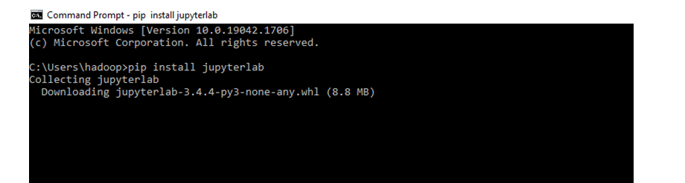
The Jupyter Notebook
The Jupyter Notebook is an open-source web application that allows you to create and share documents that contain live code, equations, visualizations and narrative text.
Uses include: data cleaning and transformation, numerical simulation, statistical modeling, data visualization, machine learning, and much more.
In the command prompt: c:\xxxxx\xx> pip install jupyterlab

Slide 34
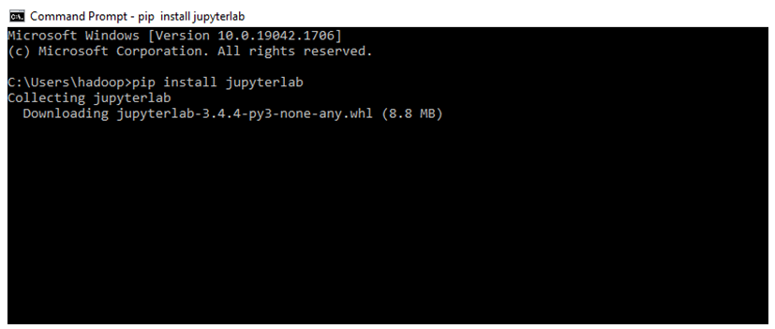

Slide 35
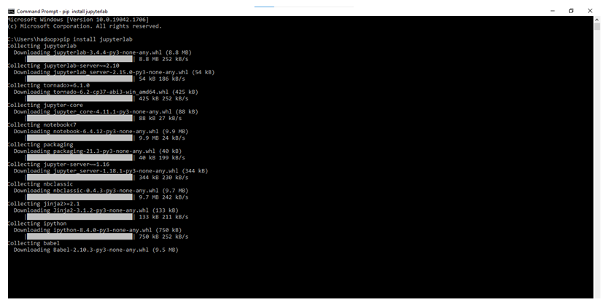

Slide 36
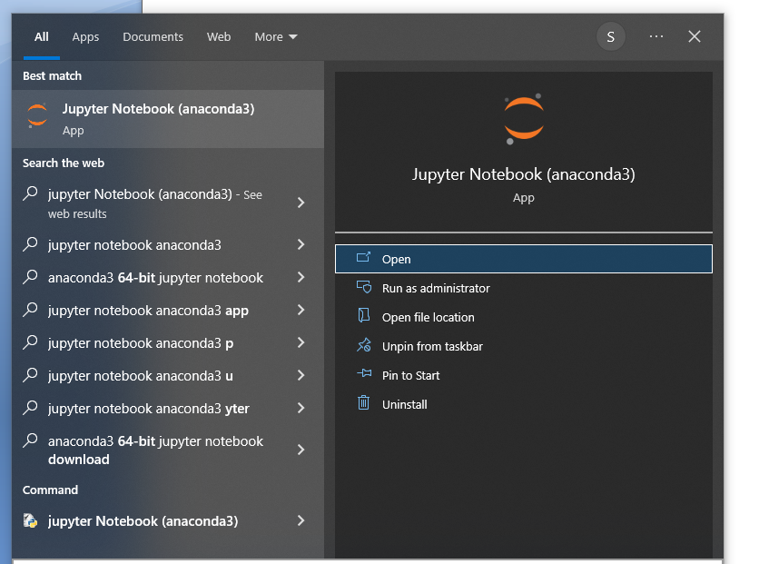
Windows → Start→ Search for Jupyter Notebook
Click → Open

Slide 37
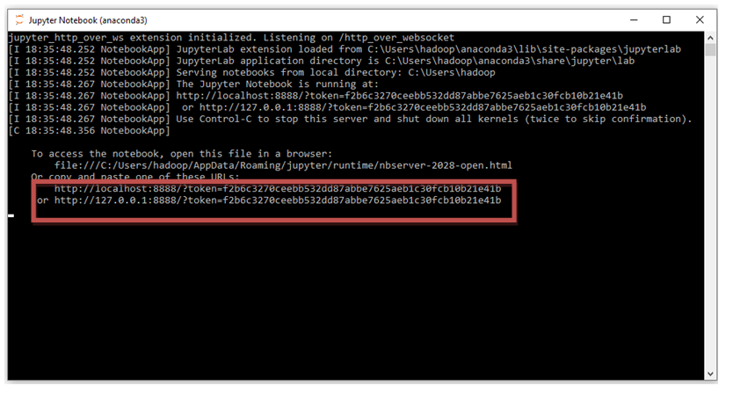
A window similar to below screenshot will be opened.
Copy and paste the link highlighted in red box in the browser as url.

Slide 38
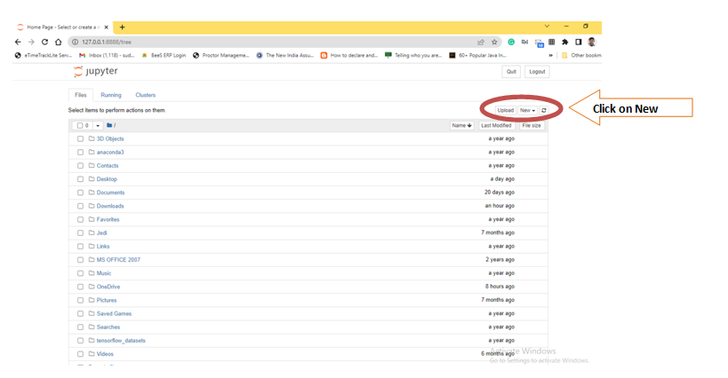
Click on New.

Slide 39
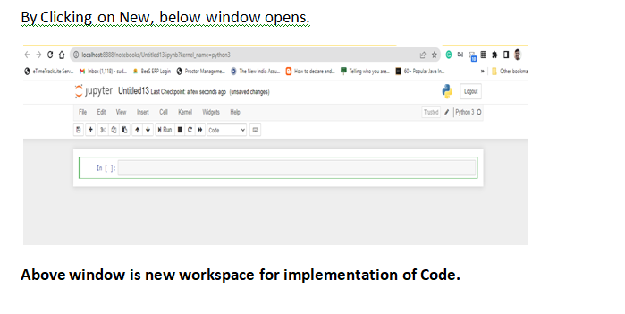

Slide 40
Introduction to Google-colab
Colaboratory, or 'Colab' for short, allows you to write and execute Python in your browser, with
Zero configuration required
Free access to GPUs
Easy sharing
Advantages
It performs all the tasks and code that Jupyter Notebook executes, using Python 2 and 3.
It is THE Google Documents of Code. The notebook can be shared and edited in real-time by different team members, add comments, see the edition history and go back to previous versions, like in google docs.
No more Anaconda. It is all cloud-based and it doesn't require any main settings or installations. If the library that you want to use is not on Colab, just pip it as usual. Being installed in the virtual environment.
Personalization. Add your own shortcuts, night/light/adaptive - mode, and fonts.
Playground mode. With 2 clicks you can enter open a new notebook that won’t be saved, and try different code options without affecting your original code.

Slide 41
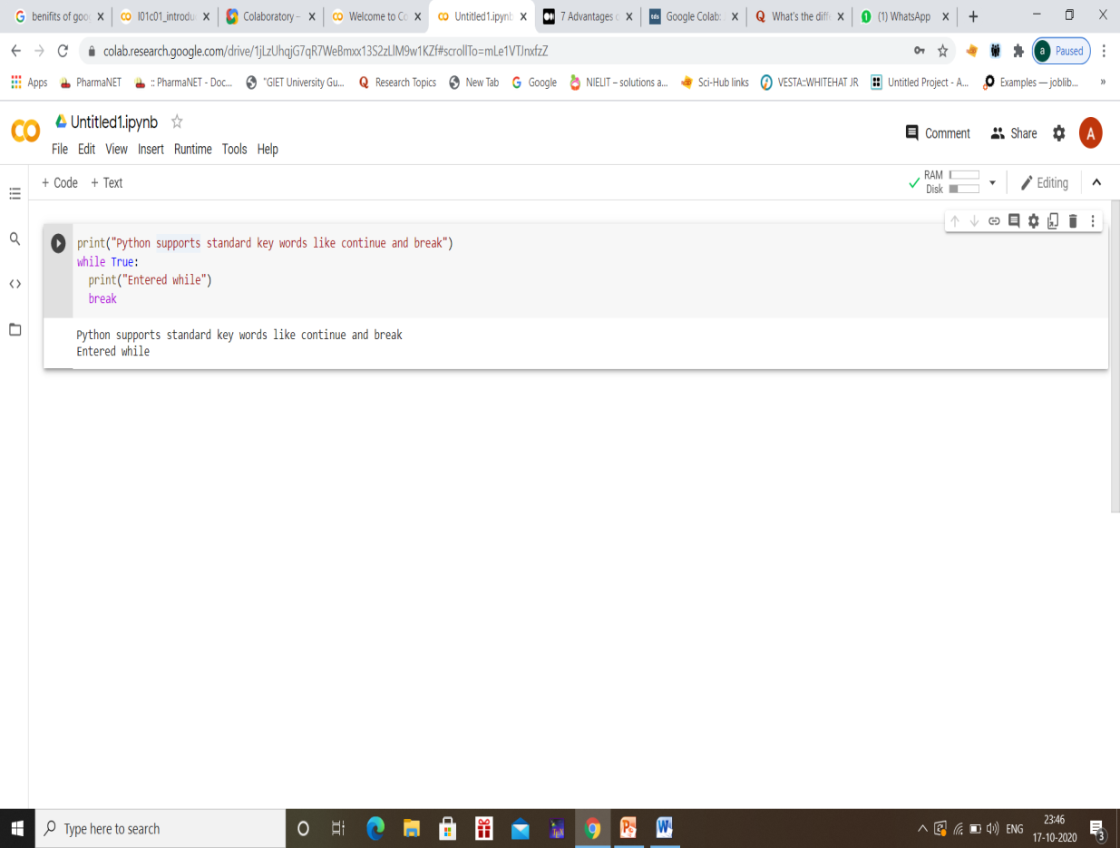

Slide 42
Assignment-1 Question
Write a python code for finding mean, median and mode with and without using library functions.
Write a python code for calculating variance and standard deviation for the set of elements with and without using library functions..
Practice some basic python programs with List, Tuple, Dictionary & string.

